Slide 1
Big Data Storage in Modern Databases
Jay Urbain, PhD
Credits:
Michael Stonebraker, Ugur Çetintemel
"One Size Fits All": An Idea Whose Time Has Come and Gone. ICDE 2005
Michael Stonebraker, Matei Zaharia , Samuel Madden

Slide 2
DB History
1970’s: relational model invented
1984: DB2 released, RDBMS declared mainstream
Circa 1990: RDBMS takes over
“One-size fits all” solution
I’m the guy with the hammer; everything is a nail
2006: ICDE paper
“One-size does not fit all”
Co-existence of several solutions
2013: One size fits none

Slide 3
Traditional RDBMS Wisdom
Dynamic row-level locking
Aries-style write-ahead log
Replication (asynchronous or synchronous)
Update the primary first
Then move the log to other sites
And roll forward at the secondary(s)

Slide 4
Traditional RDBMS Wisdom
Data is in disk block formatting, heavily encoded, either 512 or 4K bytes.
With a main memory buffer pool of blocks (pages).
Query plans
Optimize CPU, I/O
Fundamental operation is read a row
Indexing via B-trees
Clustered or unclustered

Slide 5
One size DB solution does not fit all
RDBMS’s date from the 1980’s
Basically legacy systems
Try to provide general solution to most data management problems, end up as master of none
Suffer from “The Innovators Dilemma”
Need to reconsider for big data, analytics, different apps

Slide 6
Three main DBMS markets
One-third data warehouses OLAP
One-third OLTP
One-third everything else

Slide 7
Data warehousing
Column stores are well along at replacing row stores for OLAP
Why?
Because they are a factor of 50 – 100 faster

Slide 8
Dimensional Data Model
Most warehouses have a central fact table
Who bought what item in what store at what time.
What patient was given what drug at what time by who.
Surrounded by “dimension” tables
Store, time, product, customer, ...
Patient, provider, concept,…
So-called “star/snowflake schema”
See anything written by Ralph Kimball

Slide 9
Warehouses/OLAP
Typical warehouse query reads 4-5 attributes from a 100 column fact table
Row store - reads all 100
Column store - reads just the ones you need
Compression is way easier and more productive in a column store
Each block has only one type of attribute

Slide 10
Column Store
No big record headers in a column store
They don’t compress well
A column executor is wildly faster than a row executor
Because of “vector processing”
See pioneering paper by Martin Kersten on this topic
See Vectorwise DB spun off from MonetDB

Slide 11
Column Store Vendors
Native column store vendors
HP/Vertica, SAP/Hana, Paraccel (Amazon), SAP/Sbase/IQ
Native column store vendors open source
MonetDB, LucidDB, Lucid Impala, MySQL InfiDB, MySQL ICE
Native row store vendors
Microsoft, Oracle, DB2, Netezza, PostgreSQL, MySQL
In transition – Teradata, Asterdata, Greenplum (built on PostgreSQL)

Slide 12
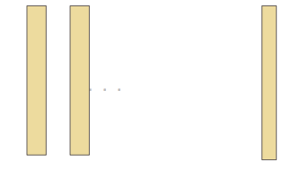
Vertica
Table is decomposed into a collection of materialized views, stored by column and sorted on all attributes left-to-right

Slide 13
Vertica
A column is stored in 64K “chunklets”.
1st attribute may be uncompressed (key) or delta encoded; remainder are compressed (delta compression, lempel-zipf, repeated values, huffman, ...)
Chunklets are decompressed only when necessary
Fundamental operation is “process a column”

Slide 14
Vertica
To load fast, there is a main memory row-store in front of this column store.
Newly loaded tuples go there
In bulk, groups of rows are sorted, converted to column format and compressed
And written to new disk segments
Segment merge makes these segments bigger and bigger
Queries go to both places

Slide 15
OLTP Databases – 3 basic decisions
Main memory versus disk orientation
Replication strategy
Concurrency control strategy

Slide 16
Reality Check on OLTP Data Bases
TP data base size grows at the rate transactions increase
1 Tbyte is a really big TP data base
1 Tbyte of main memory < $30K (2015)
~ 64 GBytes per server in 16 servers
If your data doesn’t fit in main memory now, wait a couple of years and it will.....

Slide 17
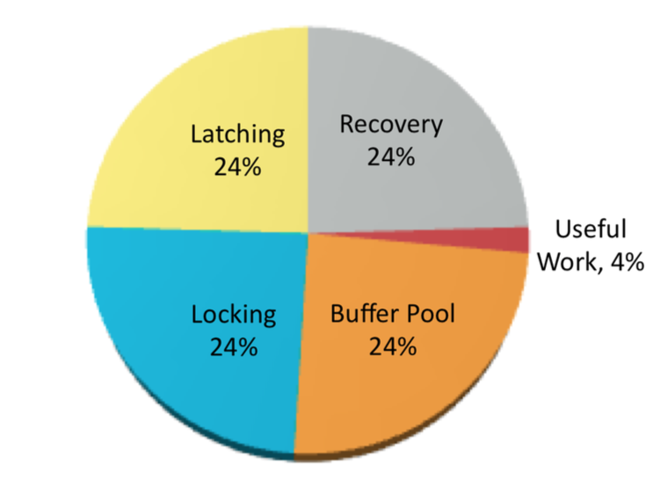
Reality Check – Main Memory Performance
TPC-C CPU cycles

Slide 18
To Go Fast
Must focus on overhead – Better B-trees to minimize path access length
Must get rid of the big four pie slices
Anything less gives you a marginal win
x10 as an example improvement

Slide 19
Single Threading
Toast unless you do this
Unless you get rid of queuing/contention
Or eliminate shared data structures
H-Store (and VoltDB) statically divide shared memory among the cores
Would be interesting to look at more flexible schemes

Slide 20
Main Memory
Toast unless you do this
What happens if my data doesn’t fit?
VLDB ‘14 paper by Debrabant et. al. – “Anti-caching”
Alternative distributed systems
To overcome the restriction that all data fit in main memory,
a new technique, called anti-caching, where cold data is moved
to disk in a transactionally-safe manner as the database grows in
size. Because data initially resides in memory, an anti-caching architecture
reverses the traditional storage hierarchy of disk-based
systems. Main memory is now the primary storage device.

Slide 21
Concurrency Control
MVCC (Multi-Version Concurrency Control) popular (Oracle, MySQL InnoDB Engine, NuoDB, Hekaton)
Each user sees a snapshot of the data at a particular point in time
Time stamp order popular (H-Store/VoltDB)
Non-locking concurrency control (e.g., Lamport timestamp/Vector Clock)
Lightweight combinations of time stamp order and dynamic locking (Calvin, Dora)
Dynamically determine the most cost effective level of granularity for locking row, rows, table, etc., based on query.
Normal dynamic locking – is too slow

Slide 22
Logging
Command logging much faster than data logging
ICDE ‘14 paper by Malvaiya
1.5x higher throughput
HA (high availability) is now a requirement
Failover to a replica; rarely recover from a log

Slide 23
The Old Way vs The New Big Data Way
Main memory not disk
Anti-caching not caching
Command logging not data logging
Failover not recovery from a log
MVCC or timestamp order, not dynamic locking
Single threaded not multi-threaded

Slide 24
Everything Else
NoSQL
Array stores
GraphDBMSs
Hadoop

Slide 25
NoSQL ~ 75 or so Vendors
Give up SQL
Completely misguided notion
SQL mathematically precise relational language
SQL does not map well to OO NoSQL – i.e., object level
Nobody codes in assembler any more!!!
Never bet against the compiler!!

Slide 26
NoSQL ~ 75 or so Vendors
Give up ACID
If you are guaranteed that you won’t need it (now or in the future) then you are ok
Otherwise, you’re in trouble

Slide 27
NoSQL ~ 75 or so Vendors
Schema later
Most support semi-structured data - adding a new “column” is trivial
Don’t have to think about your data upfront
Good or bad depending on your point of view!

Slide 28
NoSQL – Summary
Moving quickly toward SQL
Cassandra and MongoDB are moving towards SQL!
SparkSQL, Impalla, Hive
Moving toward ACID
Even Jeff Dean (Google) now admits ACID is a good idea!
NoSQL
Used to mean “No SQL”!
Then meant “Not only SQL”!
Moving toward “Not yet SQL” (i.e. convergence)!

Slide 29
NoSQL – Summary
Systems are fine for “low end” applications
E.g., document store, webby things!
E.g. protection/ authentication data bases
Etc.

Slide 30
Array DBMSs and Complex Analytics
Machine learning
Data clustering
Predictive models
Recommendation engines
Regressions
Estimators
i.e. “Data Mining”

Slide 31
Complex Analytics
By and large, they are defined on arrays
As collections of linear algebra operations
They are not in SQL!
And often
Are defined on large amounts of data
And/or in high dimension

Slide 32
Complex Analytics on Array Data – Basic Example
Consider the closing price on all trading days for the last 20 years for two stocks A and B
What is the covariance between the two time-series?
(1/N) * sum (A_{i} - mean(A)) * (B_{i} - mean (B))

Slide 33
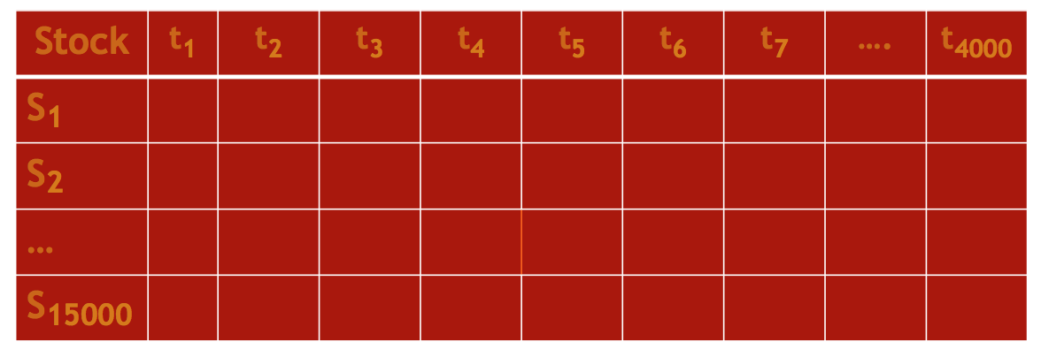
Complex Analytics on Array Data – Basic Example
Do this for all pairs of 15000 stocks
The data is the following 15000 x 4000 matrix!
… or 100,000 * n 000’s of recommendations

Slide 34
Array Answer
Ignoring the (1/N) and subtracting off the means ....
Stock * Stock^{T}

Slide 35
System Requirements
Complex analytics
Covariance is just the start – Defined on arrays
Data management
Leave out outliers
E.g., Just on securities with market cap > $10B
Need scalability to many cores, many nodes and out-of-memory data (no additional memory available)

Slide 36
Array DBMSs -- Summary
Array SQL – For joins filters,...
Built in functions – For SVD, Co-variance, ANOVA...
User-defined extensions – If you don’t see what you need
Likely to get tractions
When the world moves to complex analytics
Does not look at all like the traditional wisdom
Array DBMSs -- e.g. SciDB

Slide 37
Graph DBMSs
Focus on things like Facebook/twitter graphs
GraphLab
OLTP focus
Neo4J
Analytics focus (shortest path, minimum cut set, ...)
Can you beat – RDBMS simulations?
Array simulations
Jury is still out

Slide 38
What is Hadoop?
File system HDFS + MapReduce + extensions
Open source version of Google’s GFS + Map-Reduce
MapReduce
Map (basically filter, transform) – Reduce (basically rollup)
Very good for “embarrassingly parallel” operations
E.g. document indexing, document search, word count

Slide 39
The Hadoop Stack
Hive (or Pig) at the top
Think SQL
Hadoop (Map-Reduce) in the middle
HDFS (a file system) at the bottom
Runs across any number of nodes
Very scalable!

Slide 40
Possible Uses for Hadoop Stack
Embarrassingly parallel computations
Good – indexing, document search
SQL aggregates (e.g. warehouse-style queries)
Factor of 100 worse than a warehouse DBMS
Complex analytics
Factor of 100 worse than an array DBMS
Scientific (e.g. computational fluid
dynamics)
Factor of 100 worse than MPI-based systems

Slide 41
Hadoop Usage at Facebook
95+% Hive or Cassandra
Hadoop layer is a disaster

Slide 42
Most Likely Future
Cloudera, Hortonworks, and Facebook are ALL doing the same thing
Defining and building an execution engine that processes Hive without using Hadoop layer
Effectively moving to compete in the warehouse market
All warehouse vendors have Hive-like interfaces
There is a relatively small market for embarrassingly parallel Hadoop framework
There is a much bigger market for a Hive-SQL framework
Execution engines will look like data warehouse products
HDFS may or may not survive
It is also horribly inefficient
Spark
Distributed memory

Slide 43
Futures…
Warehouses will be a column store market
OLTP will be a main memory market
Array DBMSs and Graph DBMS may get traction
Should understand what they are good for
NoSQL
Popular for low-end applications
Especially document management, web stuff and places where you want schema-later
ACID-less

